Slide 1
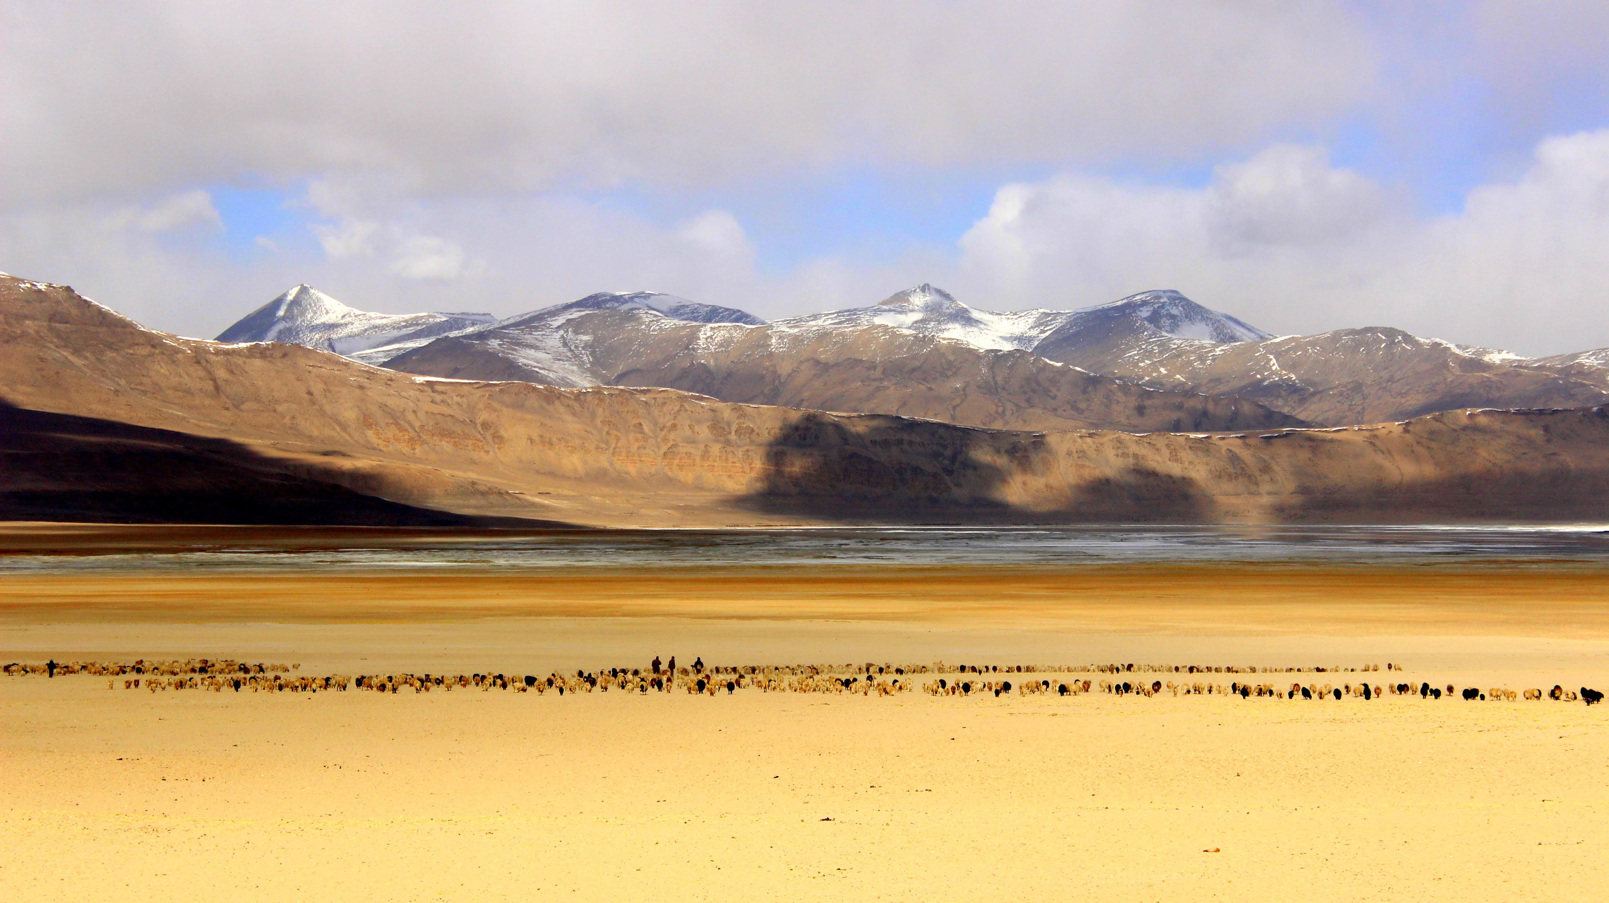
High Mountain Areas
Shiwani
School of Human Ecology
Dr B.R. Ambedkar University Delhi
Copyright Shiwani

Slide 2
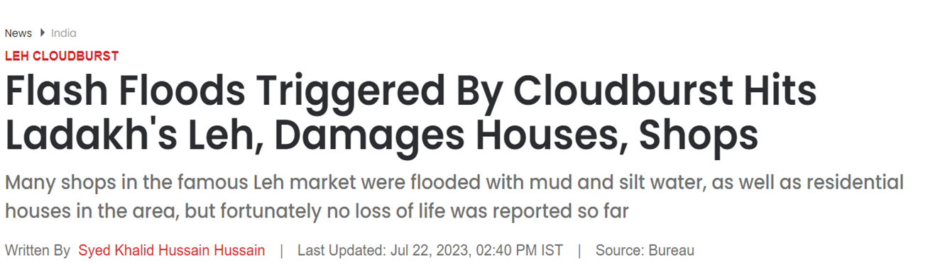
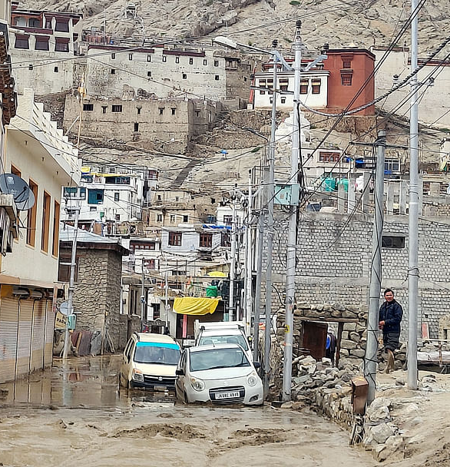
This week, July 2023!
IPPC Special Report on the Ocean and Cryosphere in a
Changing Climate Report (High Mountain Areas)
(Section 2.2.1.2, Rainfall and Snowfall)
Himalayan-Tibetan Plateau mountains -
frequency and intensity of extreme rainfall events - projected
to increase throughout the 21st century
Future projections of annual precipitation indicated
increases 5 to 20%

Slide 3
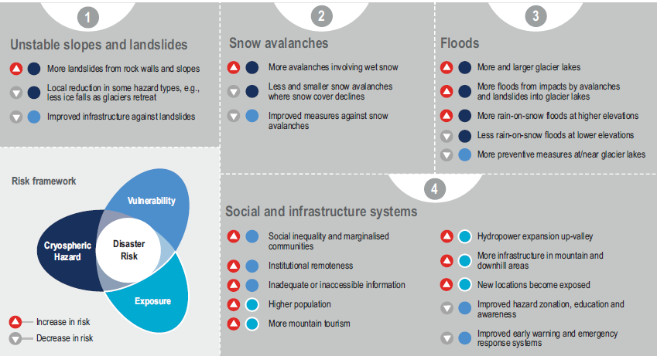
Anticipated changes in high mountain hazards under climate change

Slide 4
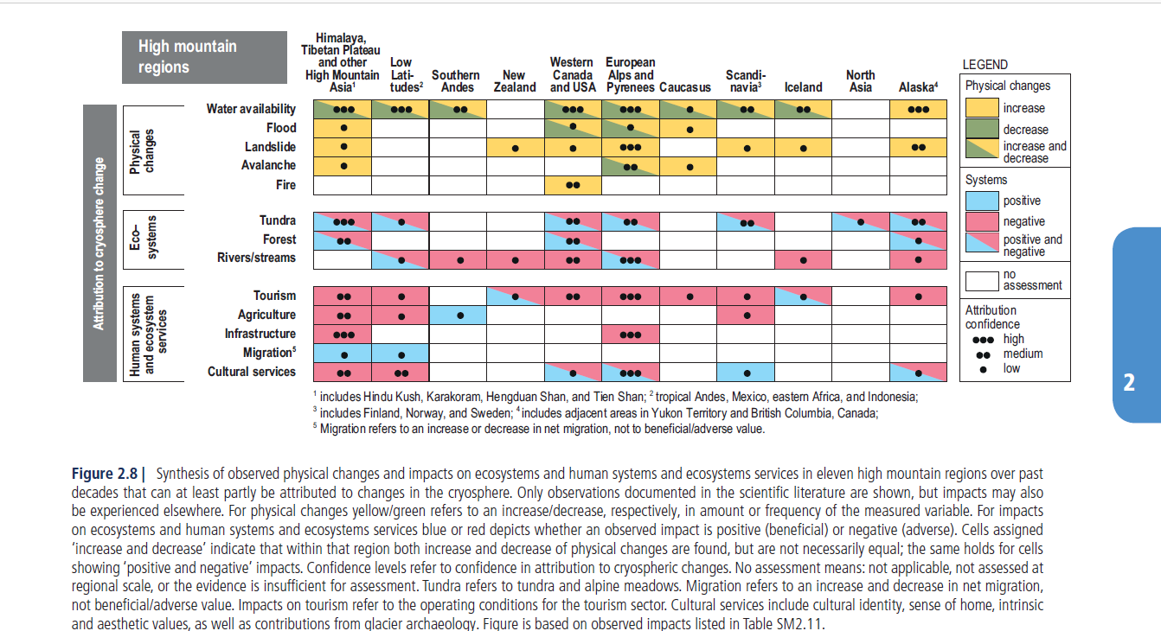
Synthesis of observed physical changes and impacts on ecosystems and human systems and ecosystems services in eleven high mountain regions over past
decades that can at least partly be attributed to changes in the cryosphere.
SROCC, Chapter 2

Slide 5
SROCC, Chapter 2

Slide 6
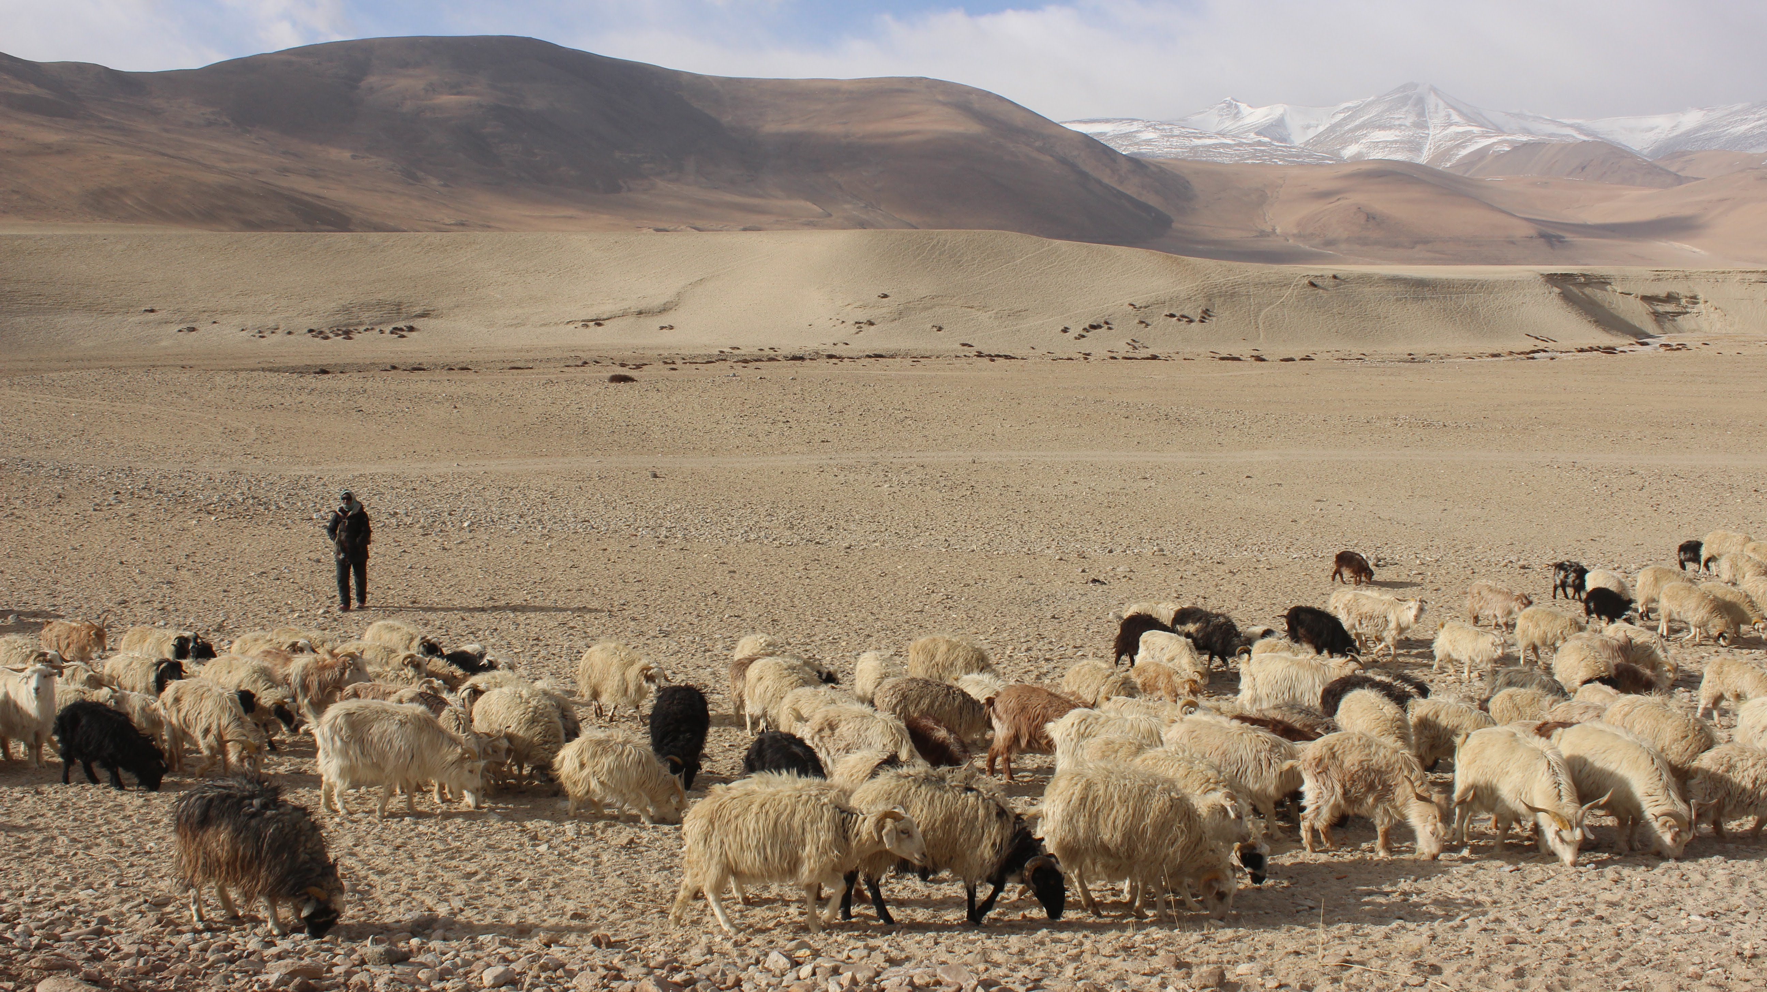
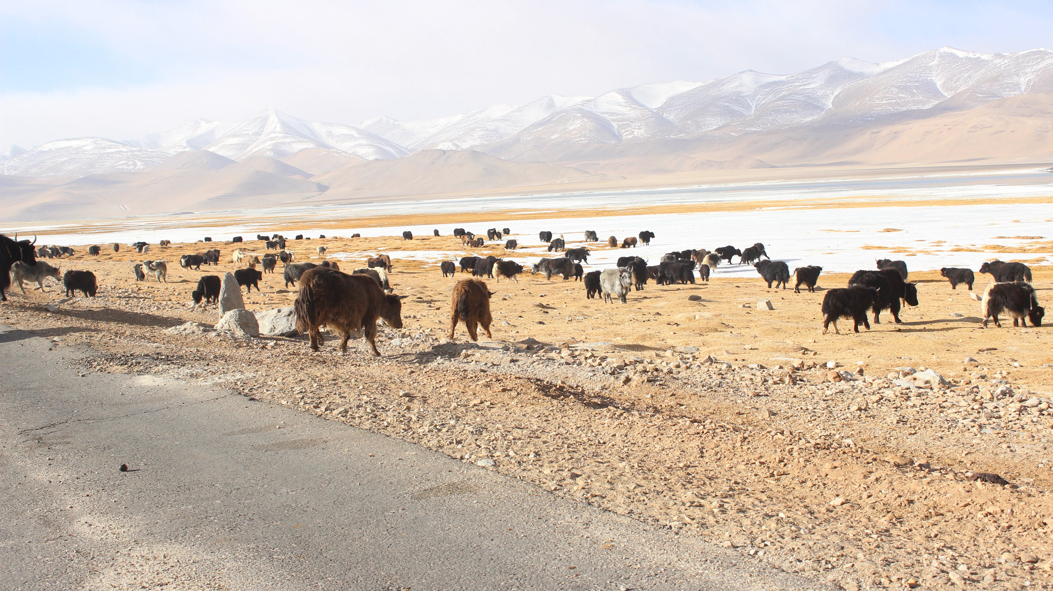
Transhumant and Nomadic pastoralism age-old practices declining.
Reasons - Climatic (in snow
distribution and glaciers) and Non-Climatic Factors (Migration, Market, etc.)
Essential to understand climatic as well as non-climatic drivers of changes!
Livestock Grazing in Tso Kar, Ladakh
Copyright Shiwani
Place : TsoKar Ladakh, India
SROCC, Chapter 2

Slide 7
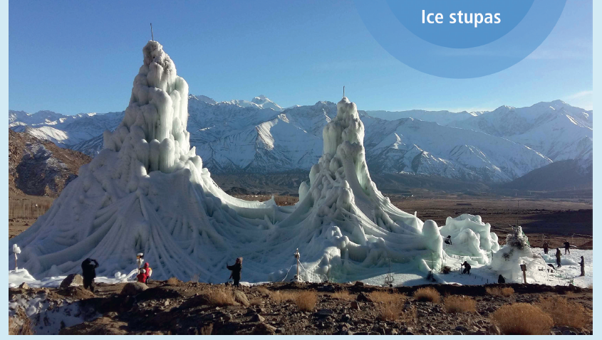
Water Conservation Strategies
SROCC, Chapter 2

